Slide 1


MICROSOFT COPILOT AND TEAMS

Slide 2
COPILOT IN TEAMS CAPABILITIES

Slide 3

Module Agenda
Setting up Microsoft CoPilot in Teams
CoPilot Capabilities in Teams
How to Setup CoPilot in Teams
Summarize Conversations in Teams Chat
CoPilot During Meetings
CoPilot After Meetings
© All rights reserved for Dr. Ryan Ahmed @Stemplicity Inc.

Slide 4
CoPilot Capabilities in Teams
Summarize Conversations in Teams Chat: CoPilot can quickly generate concise summaries of lengthy Teams chat threads, highlighting key points and action items.
CoPilot During Meetings: CoPilot provides real-time assistance by summarizing discussions, identifying action items, and answering questions during meetings.
CoPilot After Meetings: CoPilot generates detailed meeting recaps, including summaries, tasks, and decisions made, to ensure follow-up actions are clear.
© All rights reserved for Dr. Ryan Ahmed @Stemplicity Inc.

Slide 5
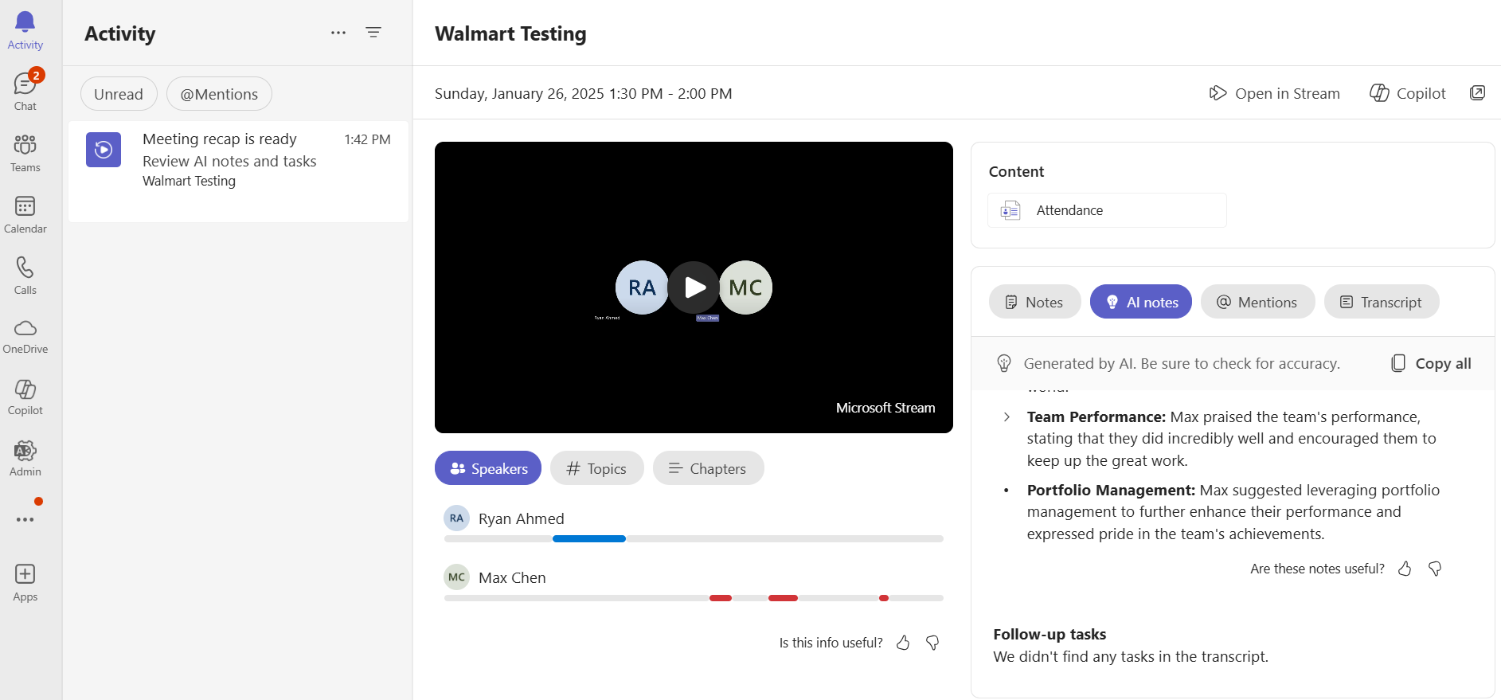
CoPilot Capabilities in Teams
© All rights reserved for Dr. Ryan Ahmed @Stemplicity Inc.

Slide 6

CoPilot Capabilities in Teams
© All rights reserved for Dr. Ryan Ahmed @Stemplicity Inc.
https://support.microsoft.com/en-us/office/use-copilot-in-microsoft-teams-meetings-0bf9dd3c-96f7-44e2-8bb8-790bedf066b1

Slide 7
COPILOT AND TEAMS SETUP

Slide 8
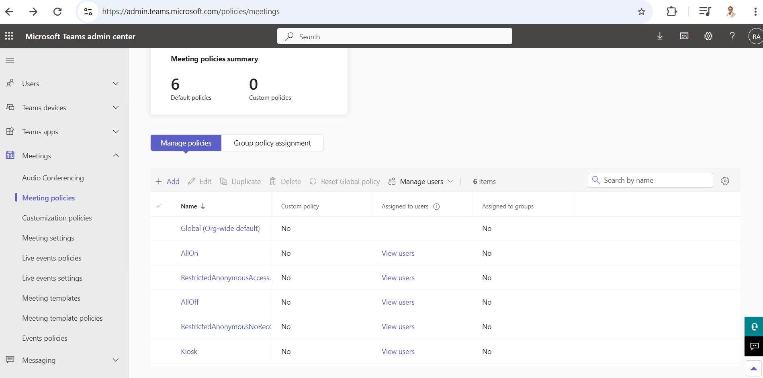
Enable Transcription in Teams
You need to enable Transcription in the Global Admin policy
For More Info: https://learn.microsoft.com/en-us/microsoftteams/copilot-teams-transcription
Link: https://admin.teams.microsoft.com/policies/
© All rights reserved for Dr. Ryan Ahmed @Stemplicity Inc.

Slide 9
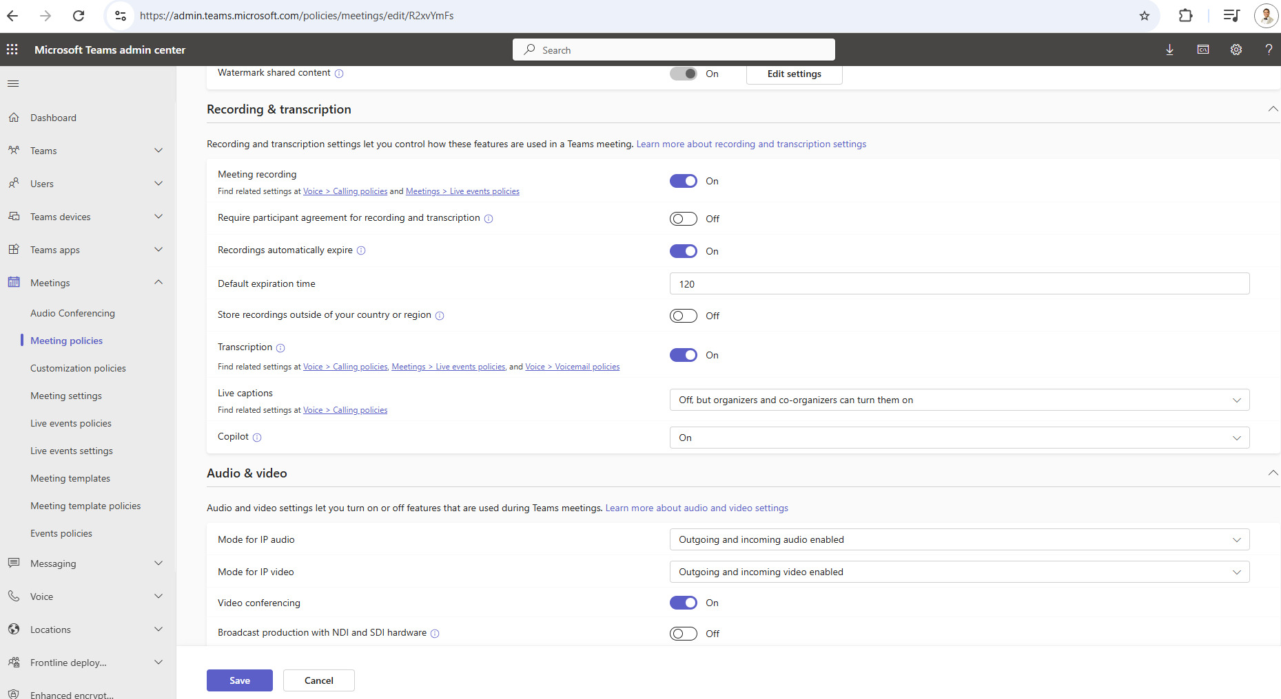
Enable Transcription in Teams
You need to enable Transcription in the Global Admin Policy and Turn CoPilot ON.
© All rights reserved for Dr. Ryan Ahmed @Stemplicity Inc.

Slide 10
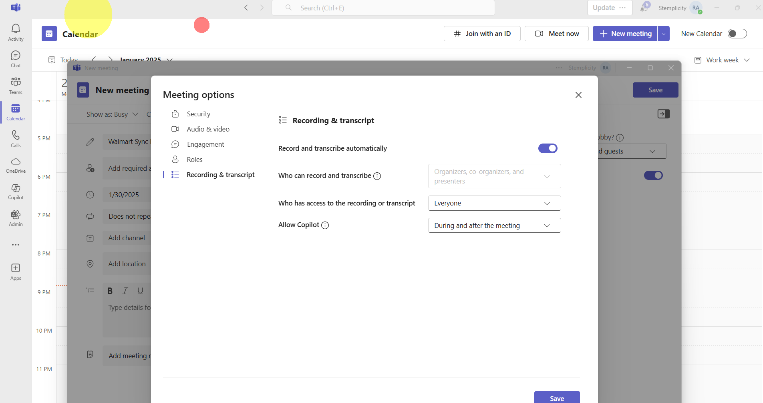
Enable Transcription in Teams
© All rights reserved for Dr. Ryan Ahmed @Stemplicity Inc.

Slide 11
LIVE DEMO

Slide 12
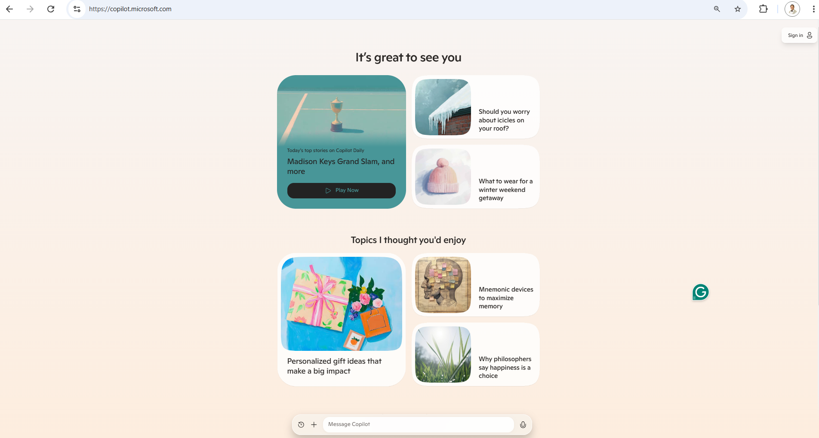
Live Demo
🔗 Click here to explore CoPilot CoPilot Signup
💡 Click here for AI Prompts Explore Prompts
© All rights reserved for Dr. Ryan Ahmed @Stemplicity Inc.

Slide 13
Thank you!

